Slide 1
Building a RESTful Web Application with Spring Boot

Slide 2

Build a RESTful service
REST architecture style HTTP response codes Annotations
Overview
Exception Handling

Slide 3
REST Architecture Style

Slide 4
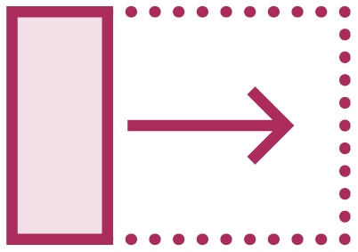



REST Architecture Style
Data and functionality are considered resources
Resources are manipulated using a fixed set of operations
Resources can be represented in multiple formats
Communication between the client and endpoint is stateless

Slide 5

Demo
RESTful APIs @RestController annotation
@RequestMapping/@GetMapping

Slide 6
Response Formats

Slide 7
Class ResponseEntity<T>
◀ ResponseEntity is generic
return new ResponseEntity<List<Ticket>
>(list, HttpStatus.OK);
return new ResponseEntity<List<Applica tion>>(list,HttpStatus.OK);
◀ Returning Tickets
◀ Returning Applications

Slide 8
Response Codes
HttpStatus.OK - 200
HttpStatus.BAD_REQUEST - 400
HttpStatus.CONFLICT - 409
HttpStatus.NOT_FOUND - 404 Not Found

Slide 9
Exception Handling

Slide 10


Response Codes
Success Status Code 200
Failure Status Code 404

Slide 11
ResponseStatusExcpeption
Programmatic alternative to @ResponseStatus
Provide HttpStatus and a reason and a cause
Exceptions can be created programmatically
Provides a default error mapping

Slide 12
Demo
Exception Handling ResponseStatusException ResponseStatusExceptionResolver

Slide 13
Build RESTful APIs
REST architecture style @RestController Automatic Configuration ResponseStatusException
Summary

